Slide 1
Hypertensive Vascular diseases
Sustained diastolic pressure more than 90 mmHg and sustained systolic pressure more than 140 mmHg constitutes hypertension.

Slide 2
Regulation of blood pressure:
The blood pressure is dependent on 2 hemodynamic variables(Cardiac output and peripheral vascular resistance). Cardiac output is dependent on blood volume which is strongly dependent on sodium concentration. Peripheral vascular resistance is controlled at the level of the arterioles and is affected by neuronal and hormonal factors. The kidneys and adrenals are the key players in the regulation of blood pressure.

Slide 3
The kidneys Influence peripheral resistance and sodium homeostasis via rennin-angiotensin system.
Low blood pressure -----Increase Na reabsorption by the proximal tubules------Volume expansion, rennin is produced by JGA----Angiotensinogen -----angiotensin I------ACE-----angiotensin II------Increase vascular resistance ------Increase aldosterone secretion.

Slide 4
Pathogenesis:
90-95% of hypertension is idiopathic (essential hypertension) which is compatible with long life unless myocardial infarction, cerebrovascular accident or other complications supervene. Most of the remainders of benign hypertension is secondary to renal disease, or narrowing of the renal arteries or less often diseases of adrenals like Cushing's syndrome and pheochromocytomas.

Slide 5
About 5% of hypertensive persons show rapidly rising blood pressure that if left untreated will leads to death within 1-2 years.
Accelerated or malignant hypertension is a clinical syndrome is characterized by severe hypertension diastolic pressure more than 120 mmHg, renal failure and retinal hemorrhage with exudate with or without edema.

Slide 6
Essential hypertension: Reduced renal sodium excretion in the presence of normal arterial pressure and vascular changes that may involve functional vasoconstriction and changes in vascular wall that result in increased resistance represent the key players in the pathogenesis of essential hypertension.

Slide 7
Both these factors are caused by:
1- Genetics factors.
2- Environmental factors like obesity, stress, smoking, physical activity and heavy consumption of salt.

Slide 8
Morphology:
1- Hyaline arteriolosclerosis: Homogenous hyaline thickening of the walls of the arterioles with loss of the underlying structural details and narrowing of the lumen. Found in elderly persons even they are normotensive and in diabetes.

Slide 9
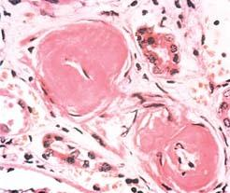

Slide 10
2- Hyperplastic arteriolosclerosis: Related to more acute or severe elevations of blood pressure (diastolic pressure more than 120mmHg). It is characterized by onion-skin concentric laminated thickening of the walls of the arterioles with luminal narrowing and fibrinoid necrosis of the walls. These laminations consist of SMCs.

Slide 11
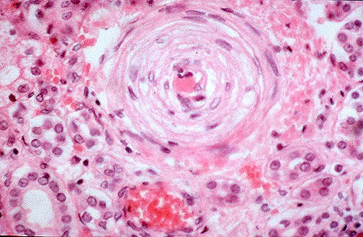

Slide 12
Aneurysm:
Is a localized abnormal dilation a blood vessel or the heart. When it involves 3 layers it is called true aneurysms.

Slide 13
1- Saccular aneurysm. It is spherical out pouching involves part of the vessel wall 5-20cm in diameter.
2-Fusiform aneurysm. It is circumferential dilation involving long segment of the vessel wall.

Slide 14
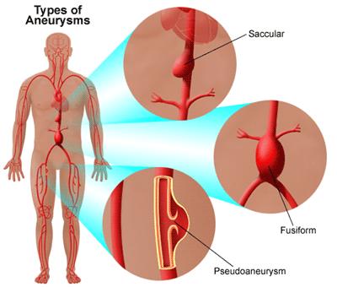

Slide 15
The 2 most common causes are ATH and cystic medial degeneration of the media. Other causes are trauma, congenital defect (berry aneurysm) and infections (mycotic aneurysm).

Slide 16
Atherosclerotic aneurysm is commonly found in the abdominal aorta. The common iliac arteries, descending part of the thoracic aorta.

Slide 17
Pathogenesis
AAA occurs more frequently in men and rarely develops before 50 years. ATH is the major cause of AAA.
AAA results from altered balance between collagen degradation and synthesis . The abnormal collagen or elastic tissue provide a back ground on which the ATH or HRT weaken the aortic wall.

Slide 18
Morphology:
Usually located below renal arteries and above the bifurcation of the aorta. AAA can be Saccular or fusiform 15 cm in diameter and 20cn in length

Slide 19
Complications
1- Rupture
2- Obstruction
3-Embolism
4-Pressure on adjacent organs.
5- Presentation as abdominal mass.

Slide 20
Aortic dissection:
It is a catastrophic event whereby blood splays apart the laminar planes of the media to form blood filled channel within the aortic wall. This channel often ruptures through the various spaces causing massive hemorrhage or cardiac temponade.
Aortic dissection occurs in men aged between 40 and 60 years.

Slide 21
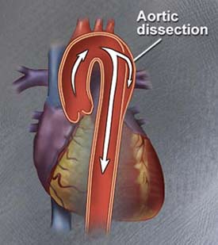

Slide 22
Morphology:
Intimal tear found in the aorta, a-5cm length the blood dissect its way within the media either proximally or distally and may extend deep to the iliac arteries. The blood usually finds its way through the adventitia causing fatal hemorrhage. Some times the blood reenters in to the blood vessels forming double barreled aorta.

